Slide 1
List ADT & Linked Lists
Visit: tshahab.blogspot.com
Notes:
Visit: tshahab.blogspot.com

Slide 2
List
A Flexible structure, because can grow and shrink on demand.
Elements can be:
Inserted
Accessed
Deleted
At any position

Slide 3
List
Lists can be:
Concatenated together.
Split into sublists.
Mostly used in Applications like:
Information Retrieval
Programming language translation
Simulation

Slide 4
List
A List is a sequence of zero or more elements of a given type (say elementtype)
Represented by a comma-separated sequence of elements:
a₁, a₂,…a_{n}
Where,
n >= 0 and each a_{i} is of type elementtype.
Notes:
Visit: tshahab.blogspot.com

Slide 5
List
if n>= 1,
a₁ is the first element
a_{n} is the last element
if n = 0,
we have an empty list

Slide 6
List
The elements of a list can be linearly ordered.
  a_{i} precedes a_{i-1} for i =2,3…n
  a_{i} follows a_{i+1} for i =1,2,3,4…n-1
  The element a_{i} is at position i.
END(L) will return the position following position n in an n-element list L.
Position END(L) has a varying distance as the list grows and shrinks, all other positions have a fixed distance from the beginning of the list.
Notes:
Visit: tshahab.blogspot.com

Slide 7
Common Operations on List ADT
INSERT(x,p,L): Insert x at position p in list L. If list L has no position p, the result is undefined.
LOCATE(x,L): Return the position of x on list L.
RETRIEVE(p,L): Return the element at position p on list L.
DELETE(p,L): Delete the element at position p on list L.
NEXT(p,L): Return the position following p on list L.

Slide 8
Common Operations on List ADT
PREVIOUS(p,L): Return the position preceding position p on list L.
MAKENULL(L): Causes L to become an empty list and returns position END(L).
FIRST(L): Returns the first position on the list L.
PRINTLIST(L): Print the elements of L in order of occurrence.

Slide 9
Implement a Linked Structure Using an Array
1
3
4
10
Need a start link.
I data[I] next[I]
0 3 6
1 * *
2 1 0
3 10 -1
4 * *
5 * *
6 4 3
start
How to insert, delete, and append?
end

Slide 10
Linked Structure Using an Array
With a free list
Free list
1
3
4
10
I data[I] next[I]
0 3 6
1 * 4
2 1 0
3 10 -1
4 * -1
5 * 1
6 4 3
Data_start
Free_start
end

Slide 11
Linked Lists
Pointer Based Implementation of Linked List ADT
Dynamically allocated data structures can be linked together to form
a chain.
A linked list is a series of connected nodes (or links) where each
node is a data structure.
A linked list can grow or shrink in size as the program runs.
This is possible because the nodes in a linked list are dynamically
allocated.

Slide 12
If new information needs to be added to the list, the program -
a) Allocates another node
b) Inserts it into the series.
If a piece of information is to be deleted from the list, the program -
a) Deletes the node containing the information
Advantages of Linked Lists over Arrays
Linked lists are more complex to code and manage than arrays,
but they have some distinct advantages.
a) A linked list can easily grow and shrink in size.

Slide 13
(The programmer doesn’t need to know how many nodes will be
in the list. They are created in memory as needed).
b) Speed of insertion or deletion from the list.
e.g. with an array, to insert an element, requires all elements beyond
the insertion point to be moved forward one position to make room
for the new element.
Similarly, to delete an element, requires all elements after
the insertion point to be moved back one position to close the gap.
When a node is inserted, or deleted from a linked list, none of the
other nodes have to be moved!!!!

Slide 14
Composition of a Linked List
Each node in the linked list contains -
a) One or more members that represent data (e.g. inventory records,
customer names, addresses, telephone numbers, etc).
b) A pointer, that can point to another node.
Data Members Pointer

Slide 15
A linked list is called “linked” because each node in the series
(i.e. the chain) has a pointer to the next node in the list, e.g.
NULL
List Head
a) The list head is a pointer to the first node in the list.
b) Each node in the list points to the next node in the list.
c) The last node points to NULL (the usual way to signify the end).
Note, the nodes in a linked list can be spread out over the memory.
Notes:
Visit: tshahab.blogspot.com

Slide 16
Declarations
How to declare a linked list in C++?
Step 1) Declare a data structure for the nodes.
e.g. the following struct could be used to create a list where each
node holds a float -
struct ListNode
{
float value;
ListNode *next;
} *head;

Slide 17
a) The first member of the ListNode struct is a float called value.
It is to hold the node’s data.
b) The second member is a pointer called next.
It is to hold the address of any object that is a ListNode struct.
Hence each ListNode struct can point to the next one in the list.
The ListNode struct contains a pointer to an object of the same type
as that being declared. It is called a self-referential data structure.
This makes it possible to create nodes that point to other nodes of
the same type.

Slide 18
Step 2) Declare a pointer to serve as the list head, e.g
ListNode *head;
Before you use the head pointer, make sure it is initialized to NULL,
so that it marks the end of the list.
Once you have done these 2 steps (i.e. declared a node data structure,
and created a NULL head pointer, you have an empty linked list.
The next thing is to implement operations with the list.
Linked List Operations
There are 5 basic linked list operations -

Slide 19
1) Appending a node
2) Traversing a list
3) Inserting a node
4) Deleting a node
5) Destroying the list
We will implement this Linked List ADT (abstract data type) that
performs basic linked list operations using the ListNode structure and
head pointer declared earlier. We use the following class
declaration -
class FloatList
{
private:
// Declare a structure for the list
struct ListNode
{
float value;
ListNode *next;
};
ListNode *head; // List head pointer

Slide 20
public:
FloatList(void) // Constructor
{ head = NULL; }
~FloatList(void); // Destructor
void appendNode(float);
void insertNode(float);
void deleteNode(float);
void displayList(void);
};
Note, the constructor initializes the head pointer to NULL,
establishing an empty linked list.
The class has members to append, insert, delete and display (all)
nodes.
The destructor destroys the list by deleting all its nodes.

Slide 21
We now examine these functions individually -
1) Appending a Node to the List
To append a node to a linked list, means adding it to the end of the list.
The appendNode member function accepts a float argument, num.
The function will -
a) allocate a new ListNode structure
b) store the value in num in the node’s value member
c) append the node to the end of the list
This can be represented in pseudo code as follows-

Slide 22
a) Create a new node.
b) Store data in the new node.
c) If there are no nodes in the list
Make the new node the first node.
Else
Traverse the List to Find the last node.
Add the new node to the end of the list.
End If.
The actual C++ code for the above pseudo code is -

Slide 23
void FloatList::appendNode(float num)
{
ListNode *newNode, *nodePtr;
// Allocate a new node & store num
newNode = new ListNode;
newNode->value = num;
newNode->next = NULL;
// If there are no nodes in the list
// make newNode the first node
if (!head)
head = newNode;
else // Otherwise, insert newNode at end
{
// Initialize nodePtr to head of list
nodePtr = head;
// Find the last node in the list
while (nodePtr->next)
nodePtr = nodePtr->next;
// Insert newNode as the last node
nodePtr->next = newNode;
}
}

Slide 24
We examine this important piece of code in detail.
The function declares the following local variables -
ListNode *newNode, *nodePtr;
a) The newNode pointer will be used to allocate and point to the new
node.
b) The nodePtr pointer will be used to travel down the linked list,
looking for the last node.
The next few statements -
i) create a new node
ii) store num in its value member.

Slide 25
newNode = new ListNode;
newNode->value = num;
newNode->next = NULL;
The last statement above is important. This node will become the
last node in the list, so its next pointer must point to NULL.
Now test the head pointer to see if there are any nodes already
in the list. If head points to NULL, we make the new node the
first in the list.
Do this by making head point to the new node, i.e.
if(!head)
head = newNode;

Slide 26
But, if head does not point to NULL, then there must already
be nodes in the list.
The else part must then contain code to -
a) Find the end of the list
b) Insert the new node.
else // Otherwise, insert newNode at end
{
// Initialize nodePtr to head of list
nodePtr = head;
// Find the last node in the list
while (nodePtr->next)
nodePtr = nodePtr->next;
// Insert newNode as the last node
nodePtr->next = newNode;
}

Slide 27
The code uses nodePtr to travel down the list. It does this by
assigning nodePtr to head.
nodePtr = head;
A while loop is then used to traverse (i.e. travel through) the list,
looking for the last node (that will have its next member pointing
to NULL).
while(nodePtr->next)
nodePtr = nodePtr->next;
Now the nodePtr is pointing to the last node in the list, so make its
next member point to newNode.
nodePtr->next = newNode;

Slide 28
This appends newNode at the end of the list.
Remember, newNode->next already points to NULL.
// This program demonstrates a simple append
// operation on a linked list.
#include <iostream.h>
#include "FloatList.h”
void main(void)
{
FloatList list;
list.appendNode(2.5);
list.appendNode(7.9);
list.appendNode(12.6);
}
(This program displays no output.)

Slide 29
We step thru the above program, observing how the appendNode
function builds a linked list to store the 3 argument values.
The head pointer is automatically initialized to 0 (NULL), indicating
the list is empty.
The first call to appendNode passes 2.5 as the argument.
A new node is allocated in memory.
2.5 is copied into its value member, and NULL is assigned to its
next pointer.

Slide 30
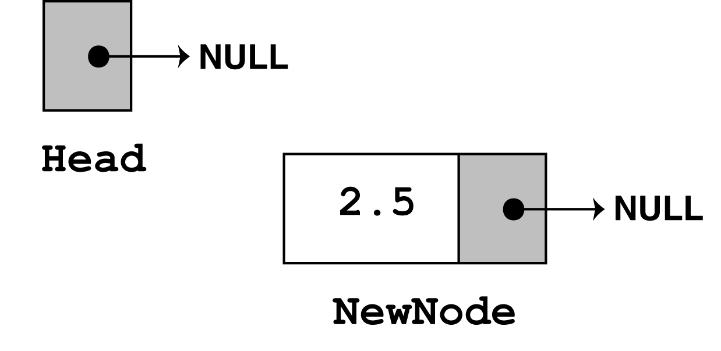
newNode = new ListNode;
newNode->value = num;
newNode->next = NULL;
The next statement to execute is the following if statement.
if (!head)
head = newNode;
Since head points to NULL, then the condition !head is true, so
the statement, head = newNode is executed, making newNode
the first node in the list.
There are no more statements to execute, so control returns to function main.

Slide 31
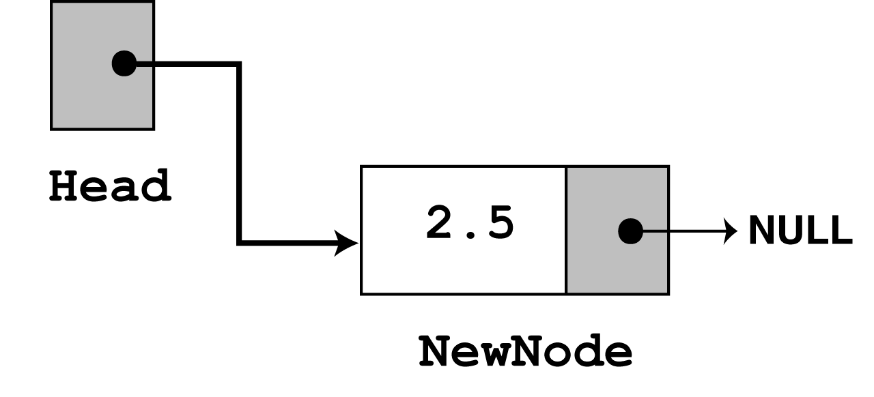
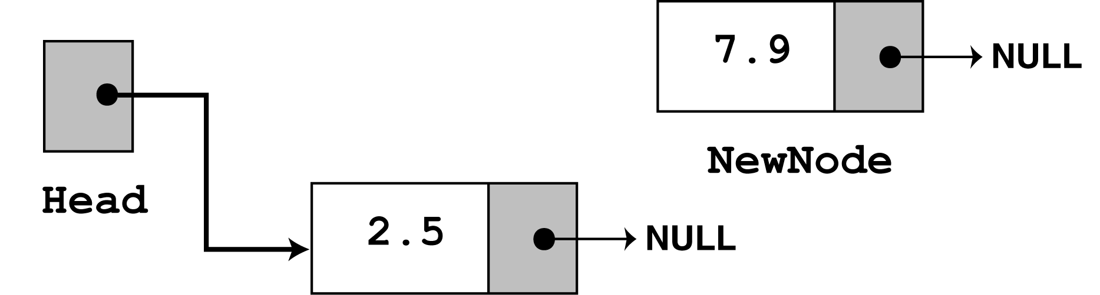
There are no more statements to execute, so control returns to the
function main.
In the second call to appendNode, 7.9 is passed as the argument.
Again, the first 3 statements create a new node, which stores the
argument in the node’s value member, and assigns its next pointer
to NULL. Visually this is -

Slide 32
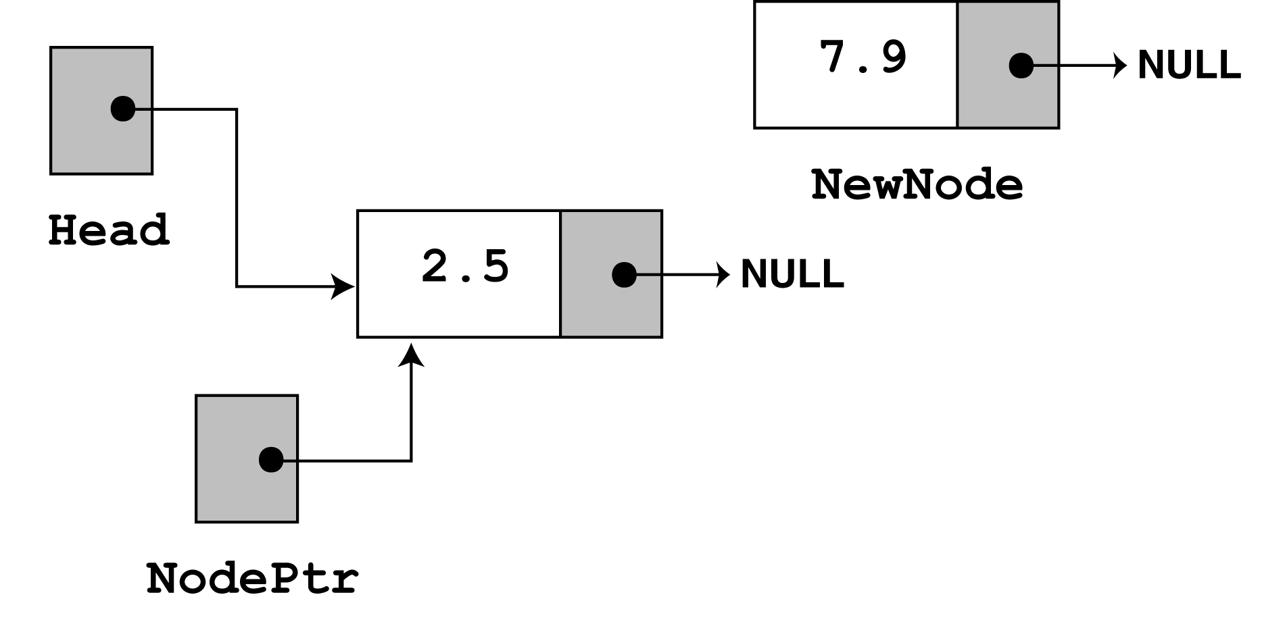
Since head no longer points to NULL, the else part of the if statement
is executed.
else // Otherwise, insert newNode at end
{ // Initialize nodePtr to head of list
nodePtr = head;
// Find the last node in the list
while (nodePtr->next)
nodePtr = nodePtr->next;
// Insert newNode as the last node
nodePtr->next = newNode;
}
The first statement in the else block assigns the value in head
to nodePtr. So, nodePtr and head point to the same node.

Slide 33
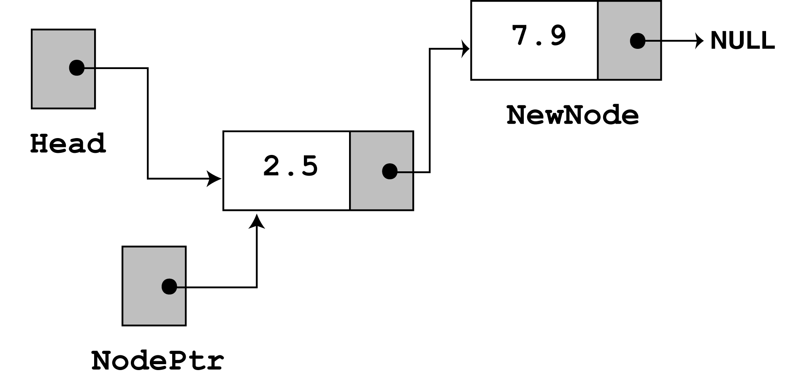
Look now at the next member of the node that nodePtr points at.
Its value is NULL, so nodePtr->next also points to NULL.
So, nodePtr is already at the end of the list, so the while loop
terminates.
The last statement, nodePtr->next = newNode, causes
nodePtr->next to point to the new node. This appends newNode to
the end of the list, as shown -

Slide 34
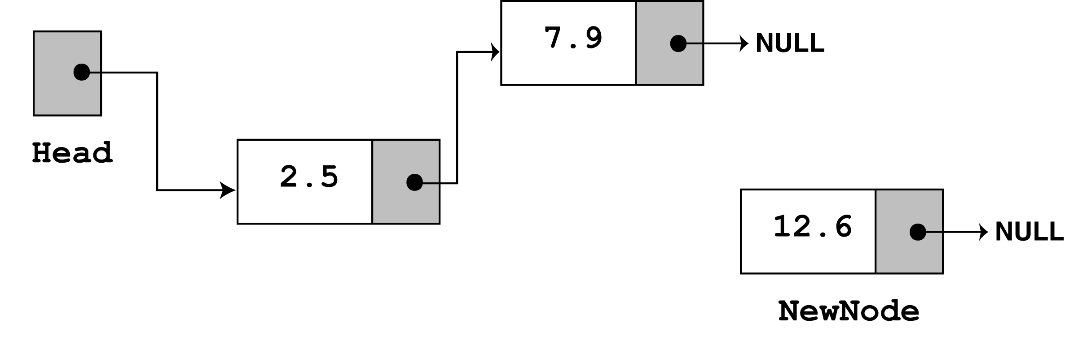
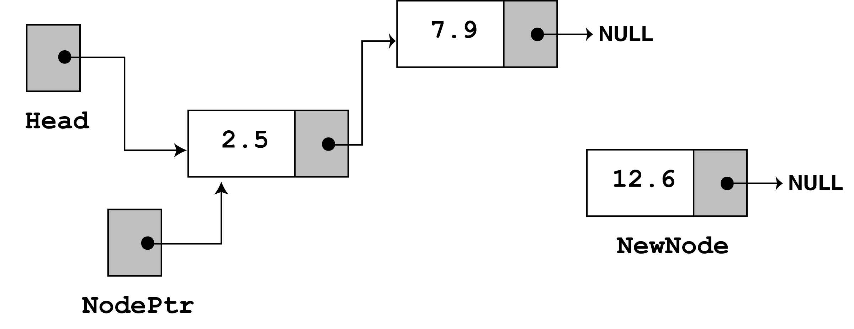
The third time appendNode is called, 12.6 is passed as argument.
Again, the first 3 statements create a node with the argument stored
in the value member.
Now, the else part of the if statement executes. Again nodePtr is
made to point to the same node as head.

Slide 35
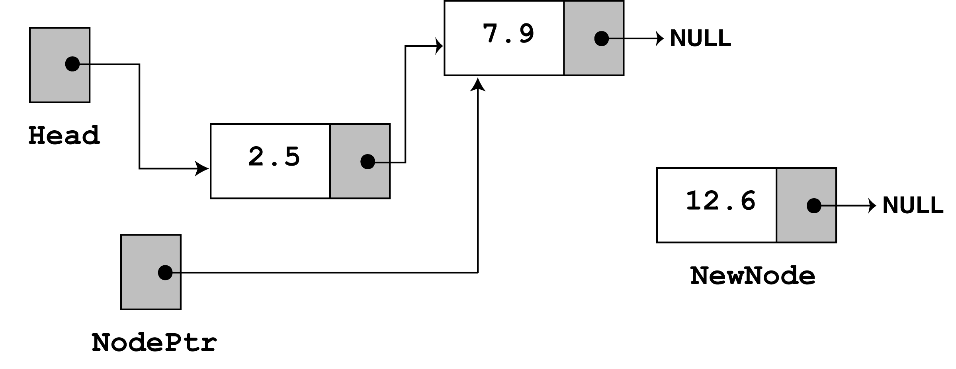
Since nodePtr->next is not NULL, the while loop will execute.
After its first iteration, nodePtr will point to the second node in the
list.
The while loop’s conditional test will fail after the first iteration
because nodePtr->next now points to NULL.
The last statement nodePtr->next = newNode causes
nodePtr->next to point to the new node. This appends newNode
to the end of the list, as shown -

Slide 36
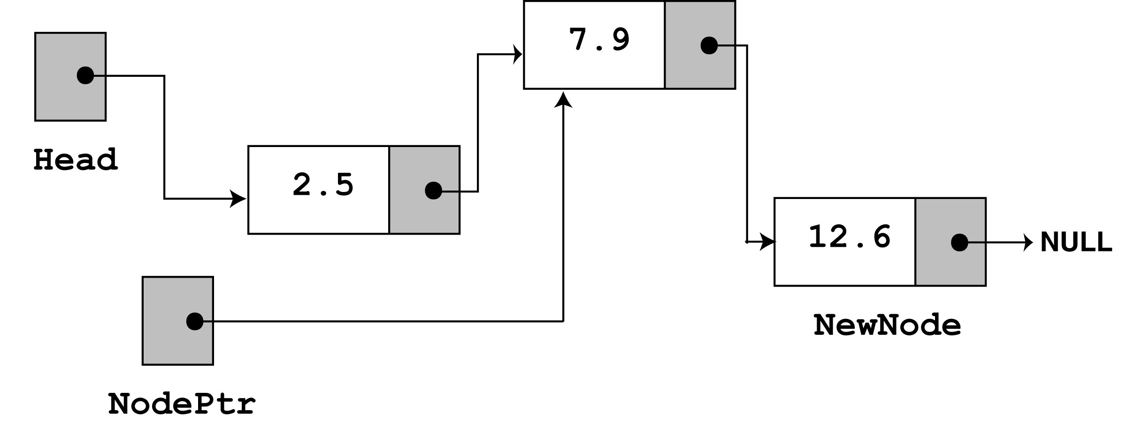
The above is the final state of the linked list.
2) Traversing a Linked List
The previous function appendNode, used a while loop that
traverses, or travels through the linked list.
We now demonstrate the displayList member function, that
traverses the list, displaying the value member of each node.

Slide 37
The following pseudocode represents the algorithm -
Assign list head to node pointer
While node pointer is not NULL
Display the value member of the node pointed to by node pointer.
Assign node pointer to its own next member.
End While.
The actual C++ code is -

Slide 38
void FloatList::displayList(void)
{
ListNode *nodePtr;
nodePtr = head;
while(nodePtr)
{
cout << nodePtr->value << endl;
nodePtr = nodePtr->next;
}
}

Slide 39
// This program calls the displayList member function.
// The funcion traverses the linked list displaying
// the value stored in each node.
#include <iostream.h>
#include "FloatList.h"
void main(void)
{
FloatList List;
list.appendNode(2.5);
list.appendNode(7.9);
list.appendNode(12.6);
list.displayList();
}
Program 17-2 Output
2.5
7.9
12.6

Slide 40
Usually, when an operation is performed on some or all of the nodes
in a linked list, a traversal algorithm is used.
We will see variations of this traversal algorithm used throughout
this chapter.
3) Inserting a Node
Inserting a node in the middle of a list is more complicated than
appending a node.
Assume all values in the list are sorted, and you want all new values
to be inserted in their proper position (preserving the order of the
list).
We use the same ListNode structure again, with pseudo code.

Slide 41
This pseudocode shows the algorithm to find the new node’s
proper position in the list, and inserting it there.
It is assumed the nodes already in the list are ordered.
Create a new node.
Store data in the new node.
If there are no nodes in the list
Make the new node the first node.
Else
Find the first node whose value is greater than or equal
the new value, or the end of the list (whichever is first).
Insert the new node before the found node, or at the end of
the list if no node was found.
End If.
Notes:
Visit: tshahab.blogspot.com

Slide 42
The code for the traversal algorithm is shown below. (As before, num holds the value being inserted into the list.)
// Initialize nodePtr to head of list
nodePtr = head;
// Skip all nodes whose value member is less
// than num.
while (nodePtr != NULL && nodePtr->value < num)
{
previousNode = nodePtr;
nodePtr = nodePtr->next;
}
The entire insertNode function begins on the next slide.

Slide 43
The new algorithm finds the first node whose value is greater than
or equal to the new value.
The new node is then inserted before the found node.
This requires two pointers during the traversal -
a) One to point to the node being inspected
b) The other to point to the previous node.
The code above shows this traversal algorithm.
Num holds the value being inserted into the list.

Slide 44
The code below uses the pointers nodePtr and previousNode.
previousNode always points to the node before the one pointed to by
nodePtr. The entire insertNode function is shown below.
void FloatList::insertNode(float num)
{
ListNode *newNode, *nodePtr, *previousNode;
// Allocate a new node & store Num
newNode = new ListNode;
newNode->value = num;
// If there are no nodes in the list
// make newNode the first node
if (!head)
{
head = newNode;
newNode->next = NULL;
}
else // Otherwise, insert newNode.
{
// Initialize nodePtr to head of list
nodePtr = head;

Slide 45
// Skip all nodes whose value member is less
// than num.
while (nodePtr != NULL && nodePtr->value < num)
{
previousNode = nodePtr;
nodePtr = nodePtr->next;
// If the new mode is to be the 1st in the list,
// insert it before all other nodes.
if (previousNode == NULL)
{
head = newNode;
newNode->next = nodePtr;
}
else
{
previousNode->next = newNode;
newNode->next = nodePtr;
}
}
}

Slide 46
// This program calls the displayList member function.
// The function traverses the linked list displaying
// the value stored in each node.
#include <iostream.h>
#include "FloatList.h”
void main(void)
{
FloatList list;
// Build the list
list.appendNode(2.5);
list.appendNode(7.9);
list.appendNode(12.6);
// Insert a node in the middle
// of the list.
list.insertNode(10.5);
// Dispay the list
list.displayList();
}

Slide 47
Program Output
2.5
7.9
10.5
12.6
As in previous program, this program calls the appendNode function 3
times to build the list with the values 2.5, 7.9, 12.6
The insertNode function is called with argument 10.5
In insertNode, the new node is created, and the function argument
is copied to its value member.

Slide 48
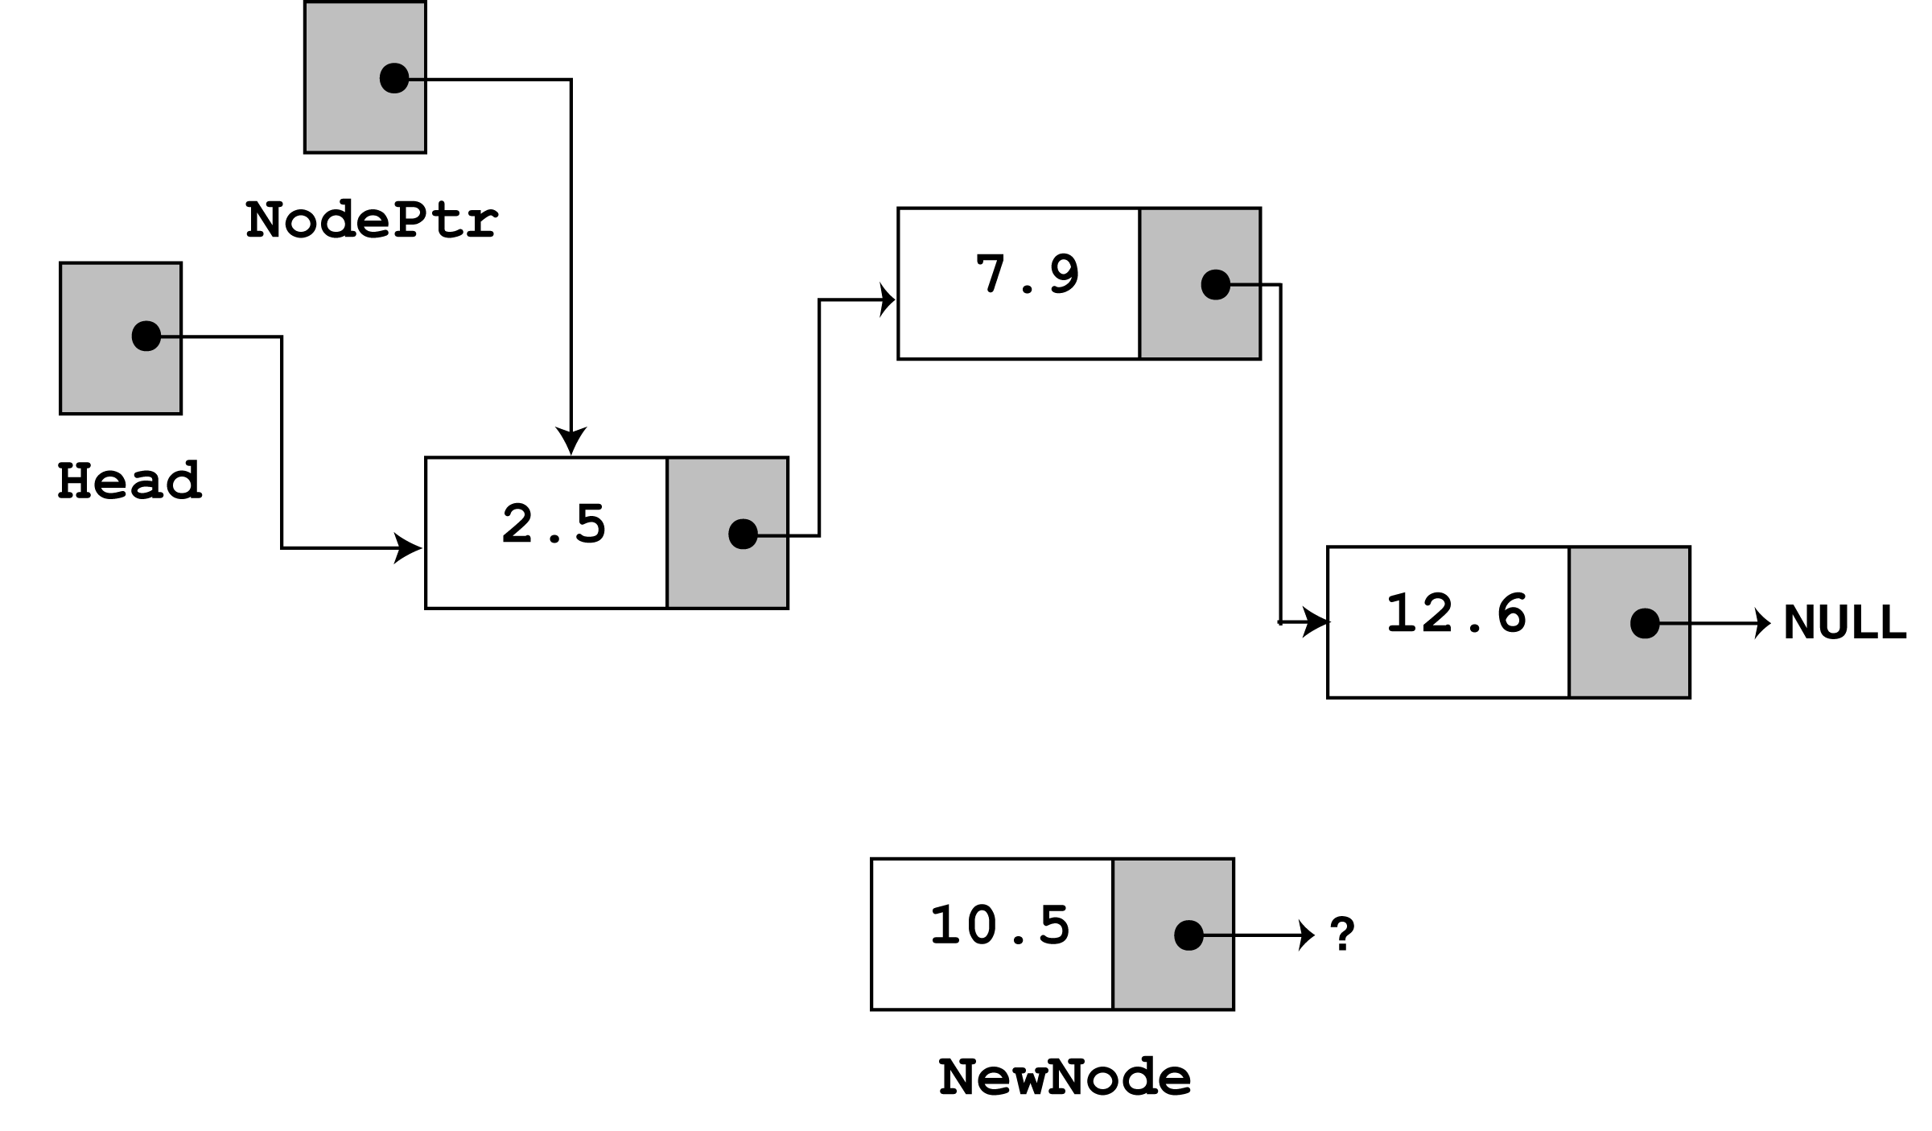
Since the list already has nodes stored in it, the else part of the if
statement will execute.
It begins by assigning nodePtr to Head, i.e.
Since nodePtr is not NULL, and nodePtr->value is less than num,
the while loop will iterate.
During the iteration, previousNode is made to point to the node
that nodePtr is pointing to. nodePtr is then advanced to point to
the next node. i.e.

Slide 49
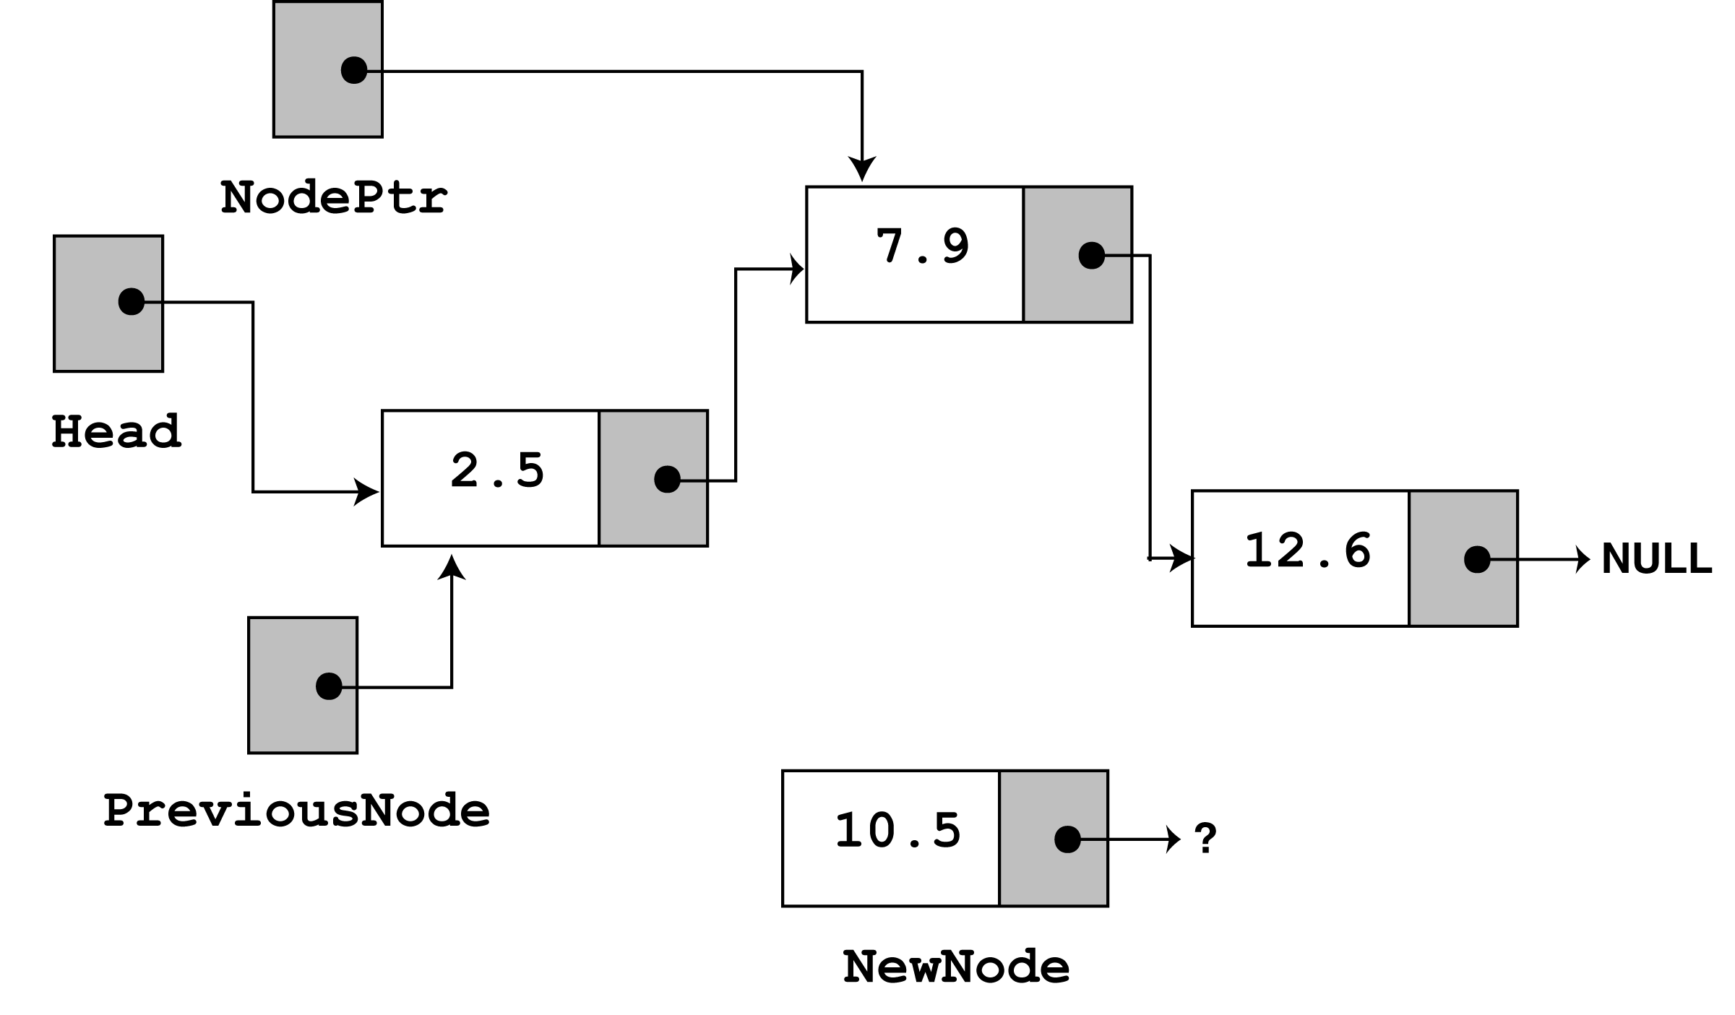
The loop does its test once more. Since nodePtr is not NULL, and
nodePtr->value is less than num, the loop iterates a second time.
During the second iteration, both previousNode and nodePtr are
advanced by one node in the list, i.e.

Slide 50
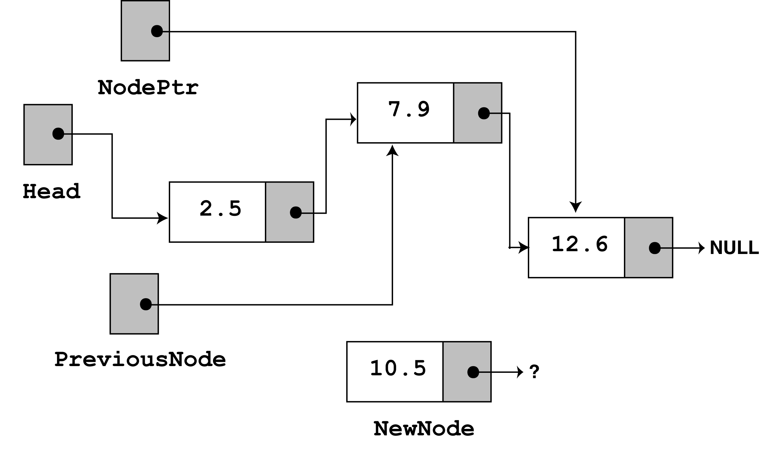
This time, the loop’s test will fail, because nodePtr is not less than
num.
The statements after the loop will execute, which cause
previousNode->next to point to newNode, and newNode->next
to point to nodePtr, i.e.

Slide 51
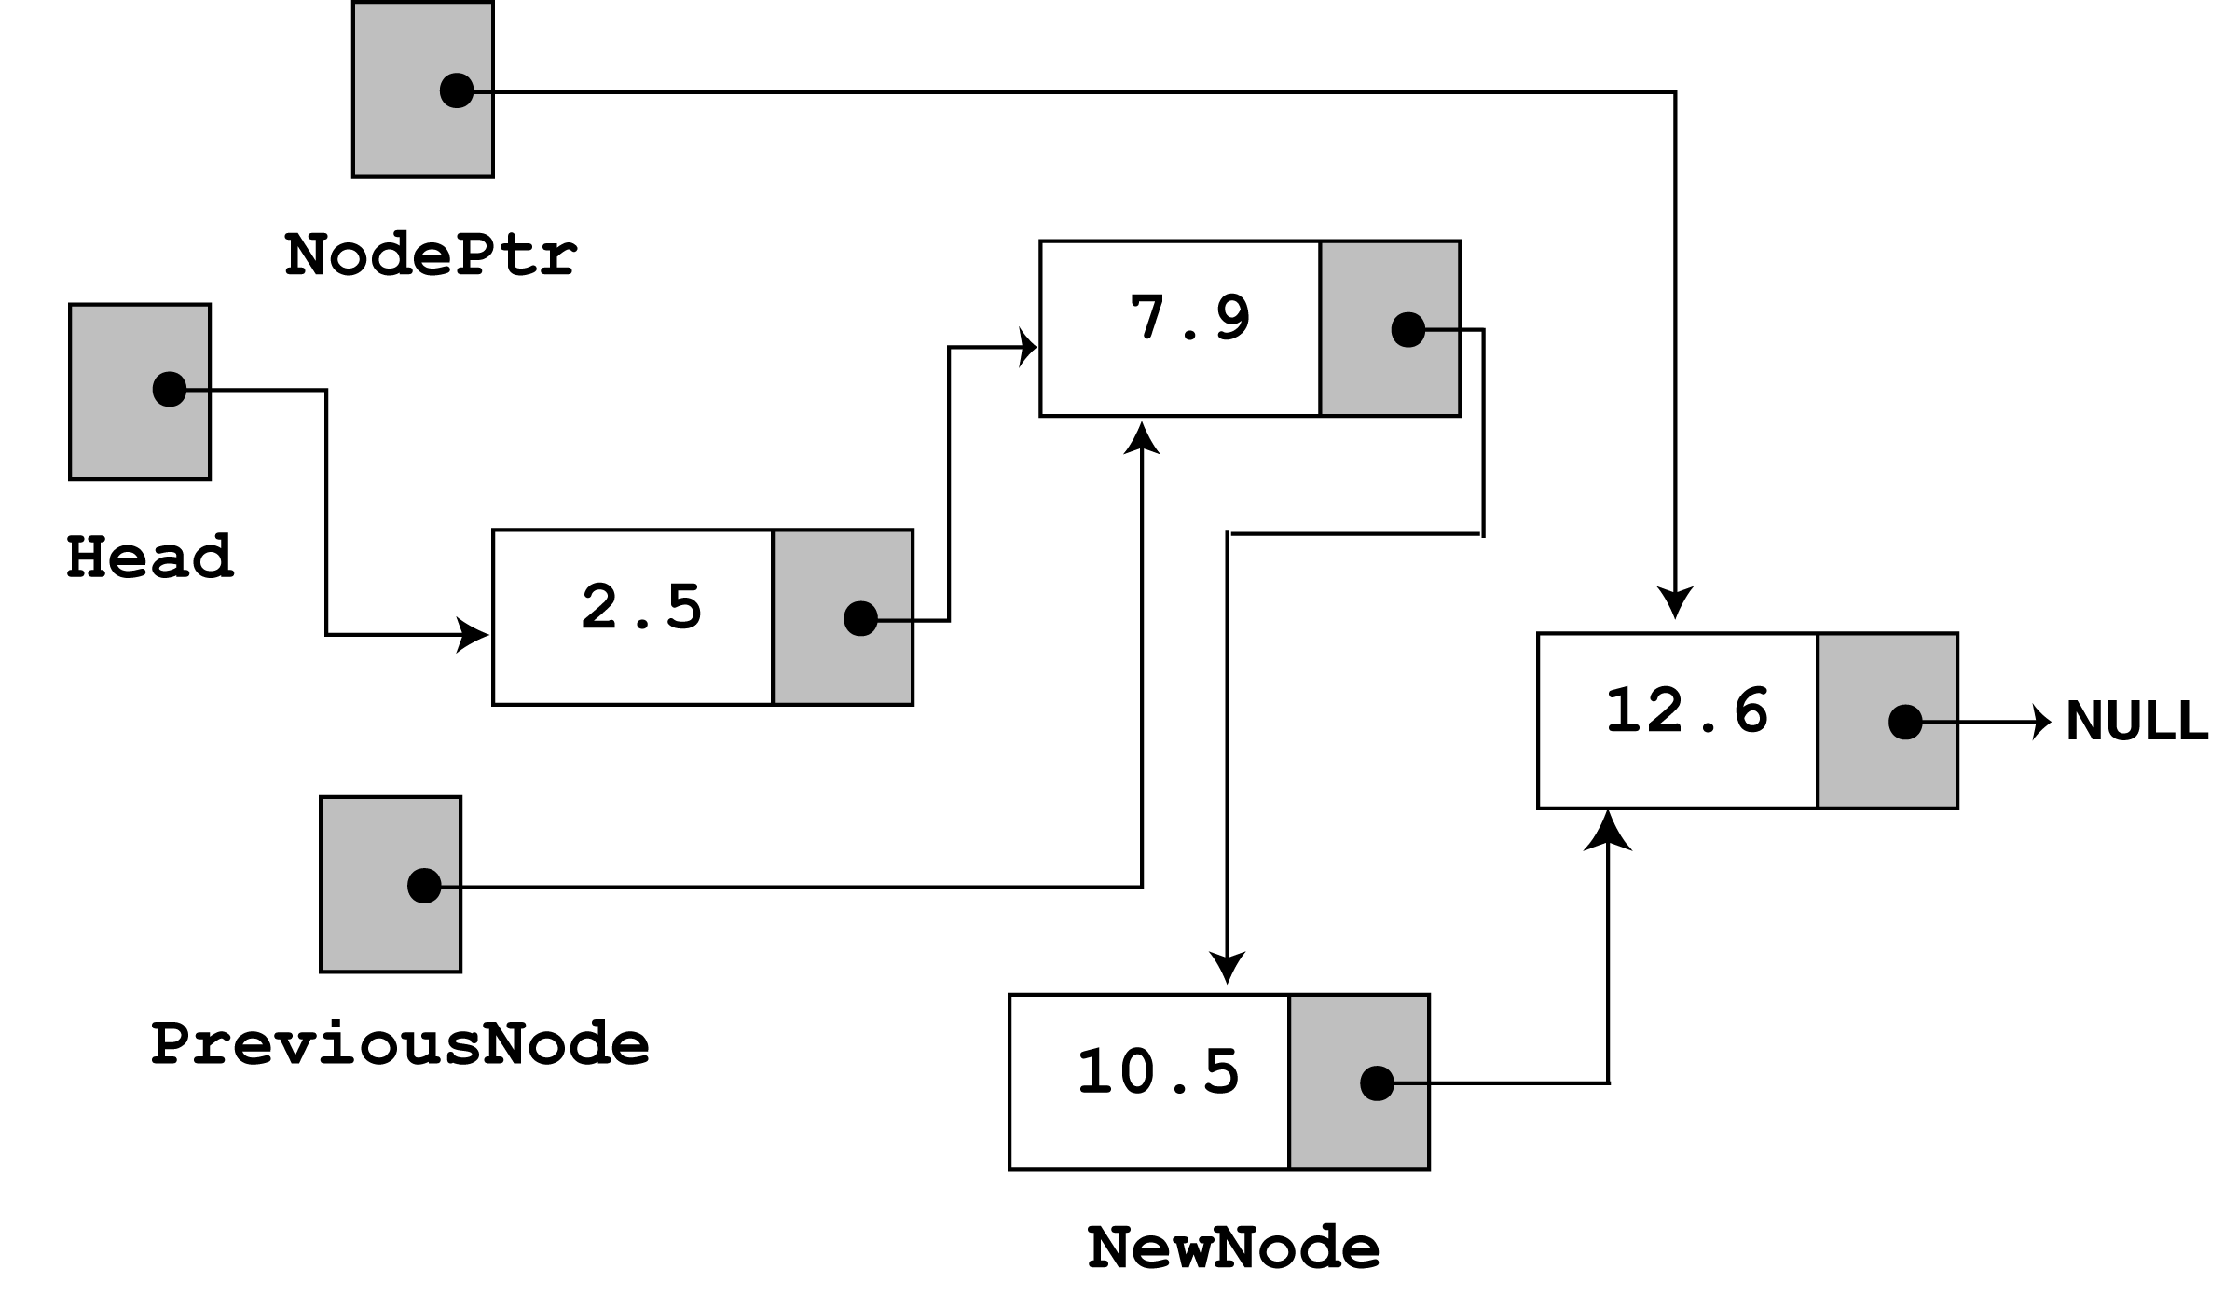
This leaves the list in its final state. The nodes (you will see if
you follow the links from the head pointer to NULL) are stored
in the order of their value members.
Deleting a Node
This requires 2 steps -
a) Remove the node from the list without breaking the links
created by the next pointers.
b) Delete the node from memory.

Slide 52
The deleteNode member function searches for a node with a
particular value and deletes it from the list.
It uses an agorithm similar to the insertNode function.
The two node pointers nodePtr and previousPtr are used to
traverse the list (as before).
When nodePtr points to the node to be deleted, previousNode->next
is made to point to nodePtr->next.
This removes the node pointed to by nodePtr from the list.
The final step is to free the memory used by the node using the
delete operator.

Slide 53
void FloatList::deleteNode(float num)
{
ListNode *nodePtr, *previousNode;
// If the list is empty, do nothing.
if (!head)
return;
// Determine if the first node is the one.
if (head->value == num)
{
nodePtr = head->next;
delete head;
head = nodePtr;
}
else
{
// Initialize nodePtr to head of list
nodePtr = head;

Slide 54
// Skip all nodes whose value member is
// not equal to num.
while (nodePtr != NULL && nodePtr->value != num)
{
previousNode = nodePtr;
nodePtr = nodePtr->next;
}
// Link the previous node to the node after
// nodePtr, then delete nodePtr.
previousNode->next = nodePtr->next;
delete nodePtr;
}
}
// This program demonstrates the deleteNode member function
#include <iostream.h>
#include "FloatList.h“
void main(void)
{
FloatList list;

Slide 55
// Build the list
list.appendNode(2.5);
list.appendNode(7.9);
list.appendNode(12.6);
cout << "Here are the initial values:\n";
list.displayList();
cout << endl;
cout << "Now deleting the node in the middle.\n";
cout << "Here are the nodes left.\n";
list.deleteNode(7.9);
list.displayList();
cout << endl;
cout << "Now deleting the last node.\n";
cout << "Here are the nodes left.\n";
list.deleteNode(12.6);
list.displayList();
cout << endl;
cout << "Now deleting the only remaining node.\n";
cout << "Here are the nodes left.\n";
list.deleteNode(2.5);
list.displayList();
}
Notes:
Visit: tshahab.blogspot.com

Slide 56
Program Output
Here are the initial values:
2.5
7.9
12.6
Now deleting the node in the middle.
Here are the nodes left.
2.5
12.6
Now deleting the last node.
Here are the nodes left.
2.5
Now deleting the only remaining node.
Here are the nodes left.

Slide 57
To show how deleteNode works, we do a step through of the call
to delete the node with value 7.9
Look at the else part of the 2nd if statement. It is here the function
does its thing, since the list is not empty, and the first node does
not contain 7.9
The node pointers nodePtr and previousPtr are used to traverse the
list (as with the insertNode function).
The while loop terminates when the value 7.9 is found. When this
happens the list and other pointers are in the following state -

Slide 58
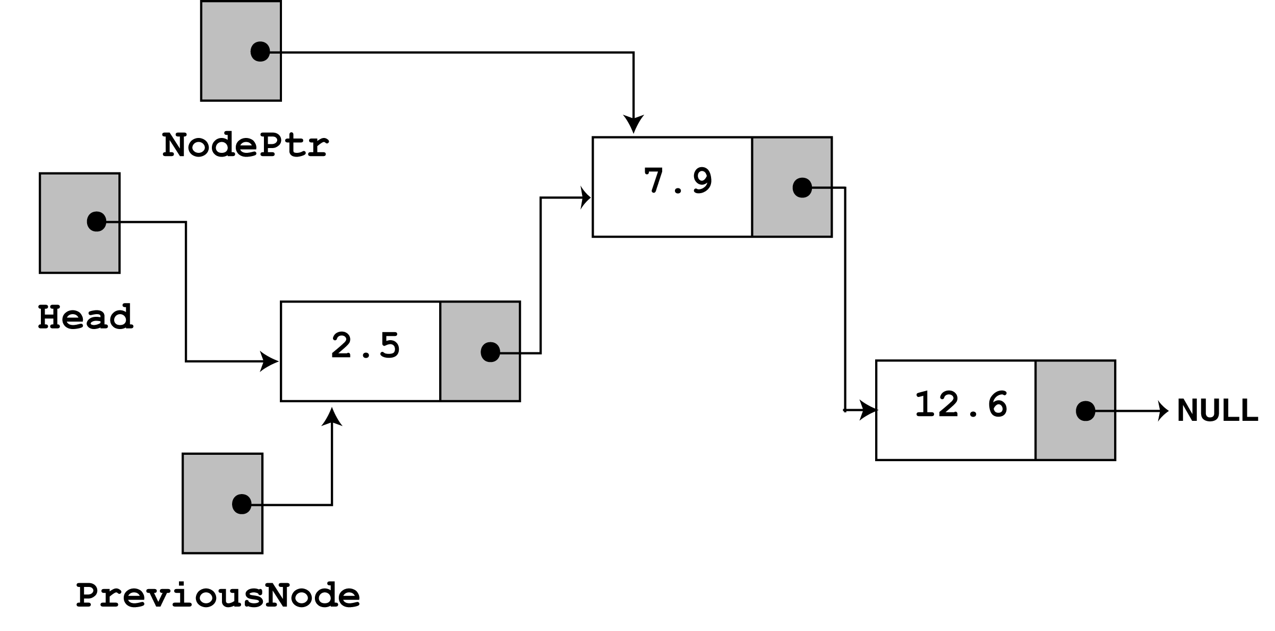
Then the following statement executes -
previousNode->next = nodePtr->next;
This causes the links in the list to bypass the node that nodePtr
points to.
The node still exists in memory, but it is removed from the list.

Slide 59
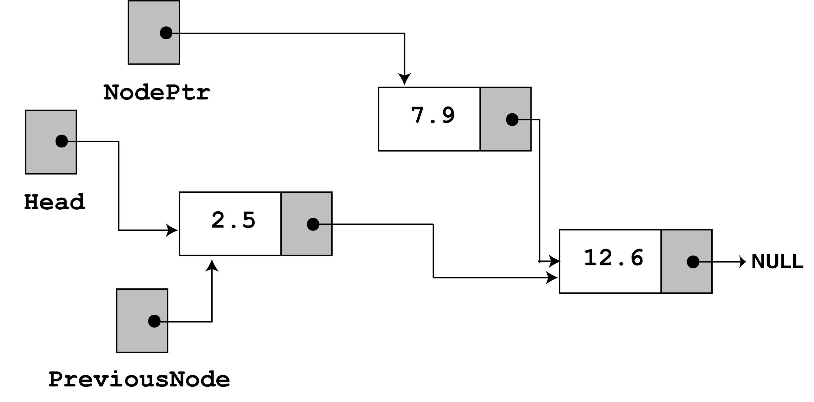
The bypassed node is destroyed with the statement delete nodePtr;
Destroying the List
Use the class’s destructor to release all the memory used by the list.
It does this by stepping through the list, deleting each node, one by one.

Slide 60
FloatList::~FloatList(void)
{
ListNode *nodePtr, *nextNode;
nodePtr = head;
while (nodePtr != NULL)
{
nextNode = nodePtr->next;
delete nodePtr;
nodePtr = nextNode;
}
}
Note the use of nextNode instead of previousNode.
The nextNode pointer is used to hold the position of the next node in the list, so it will be available after the node pointed to by nodePtr is deleted.
Notes:
Visit: tshahab.blogspot.com

